Slide 1
System Configuration Diagram
The 1st Project : The 10,000 Hour Rule
2023.12.18
Choi Jong Young

Slide 2














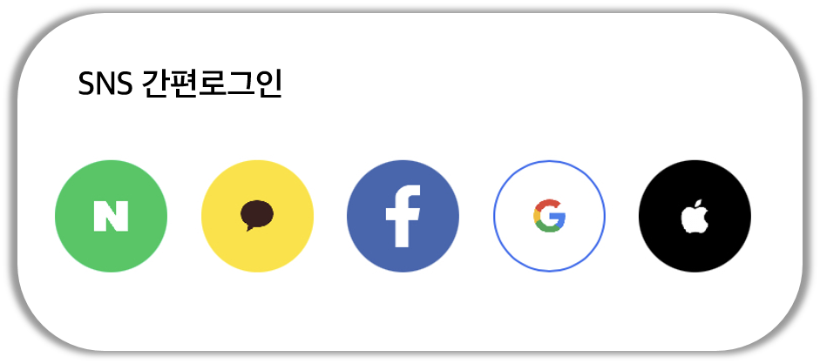
User
Server
PC Web
Web Server
Mobile Web
Web Application Server
Mobile APP

